Slide 1
Developing with Eclipse Rich Client Platform (RCP)
DATE
CITY, COMPANY Trainer: TRAINER

Slide 2
Agenda
Introduction
“Hello world!“ the RCP Way
RCP from 10000 Feet
OSGi and Plug-ins
The Workbench
Using Extension Points
RCP Applications
Products and Branding
Views
SWT Basics
JFace Standard Dialogs
JFace Viewers
The Selection Service
Commands
Wizards
Editors
i18n
Testing RCP with JUnit

Slide 3

About me: Ilya Shinkarenko
Software engineer / consultant
UI Frameworks: Eclipse RCP, Android, Flex
Eclipse RCP consulting, coaching and trainings
HCI, UX, Usability
Backends: OSGi, Spring, JBoss AS, etc.
Projects, consulting, workshops, seminars
Working in IT since 1997
Java since 2001
Eclipse RCP, OSGi since 2004
E-Mail: shinkarenko@suprematic.net

Slide 4
About me: Alexey Aristov
X
X
X
X
X
X
X
X
X
E-Mail: aristov@suprematic.net

Slide 5
About the Eclipse Training Alliance
Founded December 2005 by WeigleWilczek and Innoopract
SUPREMATIC SOLUTIONS now drives the initiative
Offerings:
International one-stop delivery of high quality Eclipse training classes
Certificates
Coaching and consulting
We share expertise

Slide 6




The Partners

Slide 7
Our Training Classes
Developing OSGi
Advanced OSGi
Developing RCP
Advanced RCP
Eclipse Modeling (EMF & GMF)
EMF Professional
Graphical Modeling with GMF
Model-Driven Development with Eclipse Modeling
MDD in the context of Software Engineering
Advanced MDD with Eclipse Modeling and openArchitectureWare
Administration Training
Architecture Training
Developer Training
Eclipse SOA Workshop
HYPERIC System Administration Training
Methodology Training

Slide 8
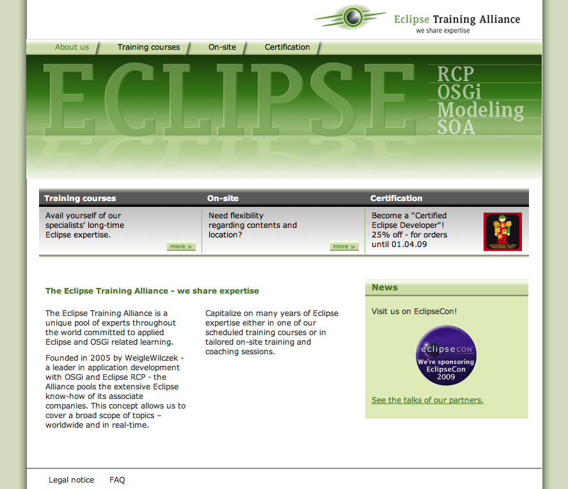
Contact Europe
Please contact us for details:
Eclipse Training Alliance
c/o CC3 GmbH
Jörn Weigle
Götzenbergstr. 34
D- 70329 Stuttgart
Phone +49 711 2203536
www.eclipse-training.net

Slide 9
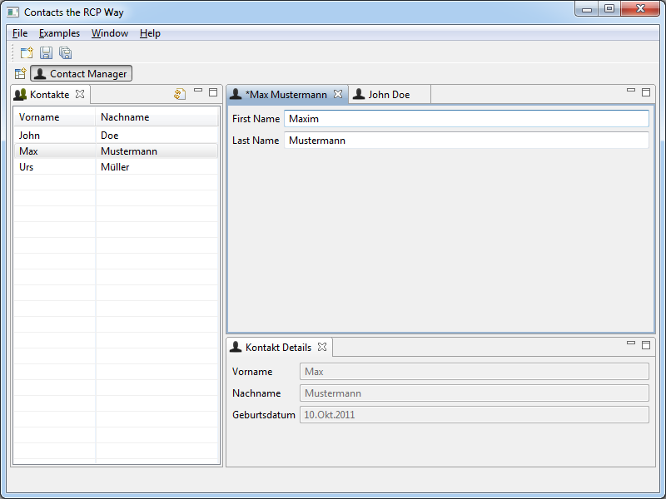
Training Goal: develop Contacts Manager
Learn Eclipse RCP architectural fundamentals
Learn how to properly design Eclipse RCP user interfaces
Learn how to use RCP multiple APIs and Extension-Points
Learn how to test and deliver the product

Slide 10
Philosophy
We try to teach the basic concepts and patterns
Slides only a guideline for the training
Labs: „learning by doing“
Approximately 40% Theory, 60% Labs
Use sources of Eclipse as a learning- and solution-example
Learn to work effectively in Eclipse IDE
Shortcuts
Tips & Tricks
There are no stupid questions!
10
Notes:
10

Slide 11
About You
What is your motivation for this training class?
What are your goals?
What experiences do you have in ...
... Java?
... UI development?
... using Eclipse as IDE?
... RCP or Eclipse plug-ins development?

Slide 12
Agenda
Introduction
“Hello world!“ the RCP Way
RCP from 10000 Feet
OSGi and Plug-ins
The Workbench
Using Extension Points
RCP Applications
Products and Branding
Views
SWT Basics
JFace Standard Dialogs
JFace Viewers
The Selection Service
Commands
Wizards
Editors
i18n
Testing RCP with JUnit

Slide 13
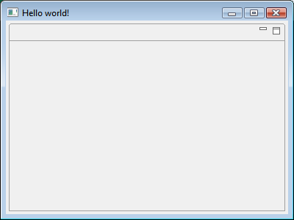
Lab #00 Objective: “Hello world!“ the RCP Way

Slide 14
Task: Get ready for Developing
Step 1:
Install Java 5 or higher
Step 2:
Install Eclipse Galileo package for RCP/Plug-in Developers
Step 3:
Start Eclipse and use a fresh workspace, e.g. “C:/rcptraining”

Slide 15
Task: Create a “Hello world!” RCP application
Step 1:
Use the “New” wizard to create a new “Plug-in Project”
Enter “hello” as project name
Uncheck “Generate an activator ...”
Select “Yes” for “Would you like ... rich client application?”
Select the “Hello RCP” template
Enter “Hello world!” as the “Application window title” and click “Finish”
Step 2:
The manifest editor will open: Click the icon or the link “Launch an Eclipse application”

Slide 16
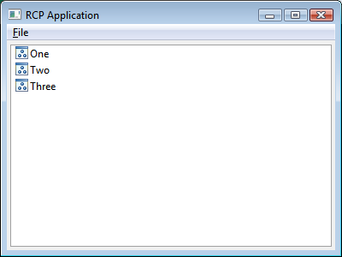
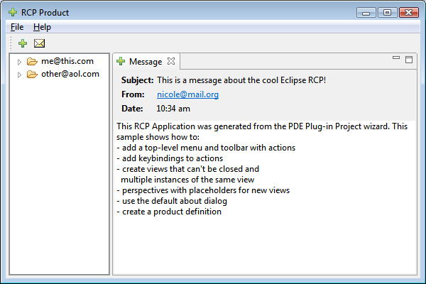
Optional Tasks
Create another RCP application from one of the other templates
“RCP application with a view”
“RCP Mail Template”: Check “Generate an activator ...”

Slide 17
Agenda
Introduction
“Hello world!“ the RCP Way
RCP from 10000 Feet
OSGi and Plug-ins
The Workbench
Using Extension Points
RCP Applications
Products and Branding
Views
SWT Basics
JFace Standard Dialogs
JFace Viewers
The Selection Service
Commands
Wizards
Editors
i18n
Testing RCP with JUnit

Slide 18
What is Eclipse?
Development environment → Eclipse SDK
Open Source → Eclipse Public License (EPL)
Community → Many projects, >1000 contributors, active blogging, ...
Managed eco-system → Eclipse Foundation
Platform for rich client applications → Eclipse RCP
...

Slide 19
Why a Rich Client Application?
Desktop app (not in web browser)
Rich UI with consistent metaphors
Integration with desktop tools and third applications
Responsive UI
Offline execution
Local data access
File system
Periphery
Lower server loads
Reduced round-trips
Client logic lives on client
Notes:
Desktop app (not in web browser)
Rich UI with consistent metaphors
Tight integration with existing Desktop tools (e.g. DnD, System Tray) and third applications (e-Signature tool for OpenX)
Responsive UI (support for concurrent operations; be scalable)
Offline execution: mechanical engineers at e.g. wind farms
Local data access: local file system and other devices (printer, card reader)
Lower server loads:
Reduced round-trips
No need to render GUI on the server
Some logic can be extracted to client

Slide 20
Where does Eclipse fit in?
Eclipse provides a common framework (RCP)
Launch vehicle for your payload
All source is provided
Large and healthy community
Corporate OSS friendly license
Eclipse Public License
No vendor or platform lock-in
Notes:
OSS = Open Source Software
open-source framework:
It’s much easier to find out why something is crashing or not behaving as you expect if you can step into it with a debugger.
Source code is the ultimate documentation.
There is often something you need to change about the software to meet your particular needs. Being able to change the source and — this is important — redistribute those changes with your product gives you the flexibility to adapt to new requirements.
Support
How many of you have called technical support for help with using some complicated technical library?
We’re developers, and we want to talk to other developers, not some front-line support people reading from a script (“Have you tried rebooting?”).
With most open-source projects, the developers and the users of the software provide the support.
License
Licenses that place restrictions on how the software can be used are often not acceptable for commercial development.
The Eclipse license allows royalty-free use of the code in commercial or non-commercial, open- or closed-source projects.

Slide 21
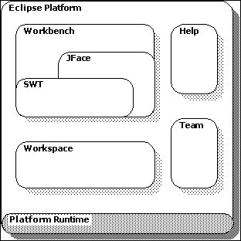
High-level RCP Architecture 1
Eclipse platform: Open tools platform
Rich Client Platform: Minimal set of plug-ins needed to build a rich client application:
org.eclipse.core.runtime
org.eclipse.ui
Prerequisites ...
Source: Eclipse Help,
Eclipse Public License Version 1.0

Slide 22
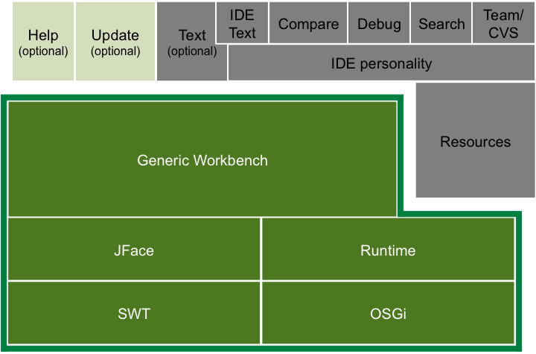
High-level RCP Architecture: Eclipse IDE

Slide 23
Extensible application vs. Platform
Extensible application
AutoCAD, Photoshop, …allow plug-ins (more precisely: add-ons)
Eclipse Rich Client Platform
it has an open, extensible architecture
built out of layers of plug-ins
not a monolythical system!
Ext.
Ext.
Ext.
Ext.
plug-in
plug-in
plug-in
Main application
plug-in
plug-in
plug-in
plug-in
Runtime kernel
Notes:
Plugins are, in fact, Eclipse components
Each plugin is a OSGi bundle

Slide 24
Further Information
Presentation “What is Eclipse?” by Wayne Beaton
Eclipse Wiki
wiki.eclipse.org/index.php/Rich_Client_Platform
wiki.eclipse.org/index.php/RCP_FAQ
Eclipse Corner Articles: www.eclipse.org/articles
Books:
We recommend “Eclipse Series” books
“Eclipse Rich Client Platform” by Jeff McAffer and Jean-Michel Lemieux
“Building Commercial Quality Plug-ins” by Eric Clayberg and Dan Rubel
Presentation “Eclipse RCP: Tips & Tricks” by Kai Tödter

Slide 25
Agenda
Introduction
“Hello world!“ the RCP Way
RCP from 10000 Feet
OSGi and Plug-ins
Using Extension Points
The Workbench
RCP Applications
Products and Branding
Views
SWT Basics
JFace Standard Dialogs
JFace Viewers
The Selection Service
Commands
Wizards
Editors
i18n
Testing RCP with JUnit

Slide 26
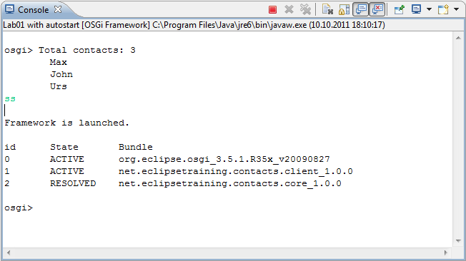
Lab #01 Objective:

Slide 27
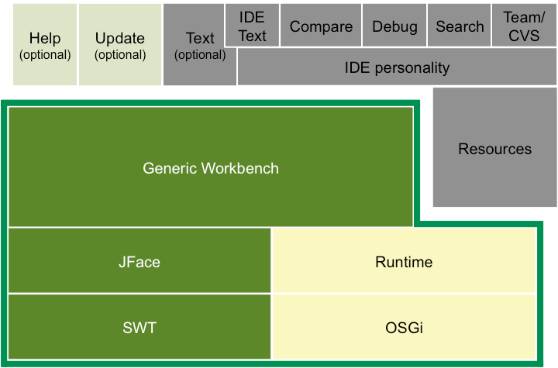
High-level RCP Architecture

Slide 28
Modular Architecture
Eclipse is not a monolithic system but an open platform
Eclipse is based on an modular and extensible architecture:
Minimal runtime
Applications are composed of modules called bundles or plug-ins
Plug-ins can be added, updated or removed
Runtime
Plug-in
Plug-in
Plug-in
Plug-in

Slide 29
Eclipse is based on OSGi
OSGi is specified by the OSGi Alliance: www.osgi.org
Non-profit corporation
Worldwide consortium, e.g. IBM, Oracle, SAP, Siemens, Sun, ...
“OSGi technology is the dynamic module system for Java”
OSGi is a widespread and well-adopted standard
Several open-source implementations:
Eclipse Equinox
Apache Felix
Knopflerfish OSGi
Equinox adds several features, e.g. extension points

Slide 30
What is a Bundle/Plug-in?
Bundles are components:
Execution in a runtime container → e.g. Eclipse Equinox
Well defined deployment format → JAR file
Declared public API → exported packages
Declared dependencies → imported packages or required bundles
Well defined life cycle → installed, resolved, active, uninstalled
Eclipse bundles (plug-ins) may offer extension points
Eclipse RCP applications are built from plug-ins:
Ext. point
Plug-in
Plug-in
Plug-in
Plug-in

Slide 31
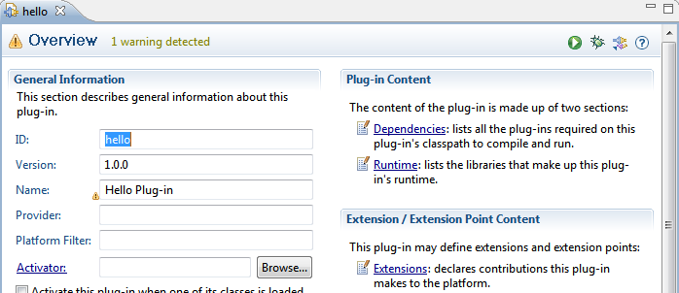
The Plug-in Development Environment (PDE)
PDE supports plug-in development:
Plug-in projects: Build path derived from MANIFEST.MF
Manifest editor for MANIFEST.MF and plugin.xml manifest files
Run/launch configurations for Eclipse applications and OSGi
...

Slide 32
The Target Platform (1)
You are developing your business plug-ins in the Eclipse workspace
Eclipse’s PDE tooling supports you in doing so
But where are the plug-ins located that are defining the RCP infrastructure itself (the so called target platform)?

Slide 33
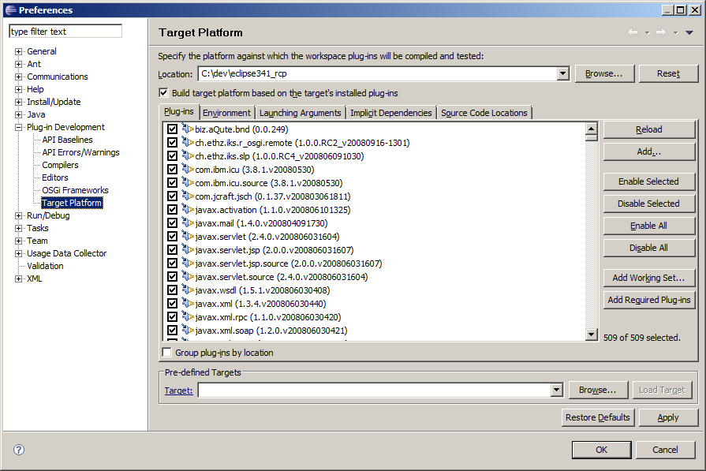
The Target Platform (2)
You can locate the target platform when you click on “Window” / “Preferences” / “Plug-in Development” / “Target Platform”:

Slide 34
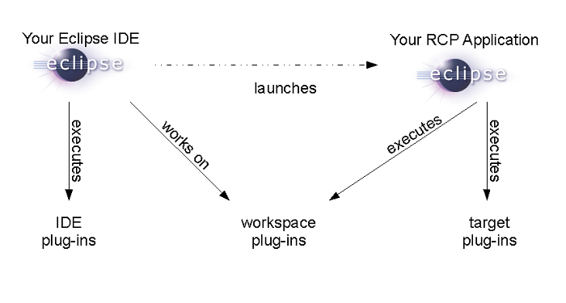
The Target Platform (3)
By default the target platform is identical with your Eclipse IDE’s “plugins” folder
Nothing prevents you from switching it to other targets
This will be even needed if you want to develop plug-ins that are based on an older version of RCP!

Slide 35
Task: Set a pre-defined Target Platform
Step 1: import the Target Platform project
Archive file: /solutions/00 - Target definintion.zip
Project name: net.eclipsetraining.contacts.target
Step 2: Set the Target Platform
Open the Target Platform definition file: /net.eclipsetraining.contacts.target/contacts.target
Click on “Set as Target Platform” hyperlink
Step 3: see the list of available Target Platforms
Open Preferences dialog (Menu Window/Preferences)
Search for “Target Platform”

Slide 36
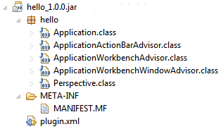
How does a Plug-in look like?
Plug-ins are common JAR archives,
... MUST contain a bundle manifest (MANIFEST.MF) and
... MAY contain classes, plug-in manifest (plugin.xml) and other artifacts

Slide 37
The Bundle Manifest (MANIFEST.MF)
Located at : META-INF/MANIFEST.MF
Text file with property-like syntax: Manifest headers with values
Declares metadata, public API, dependencies etc.
Manifest-Version: 1.0
Bundle-ManifestVersion: 2
Bundle-Name: Contacts Core
Bundle-SymbolicName: net.eclipsetraining.contacts.core
Bundle-Version: 1.0.0
Bundle-Vendor: WeigleWilczek
Bundle-RequiredExecutionEnvironment: J2SE-1.5
Export-Package: net.eclipsetraining.contacts.core;version="1.0.0"

Slide 38
Declaring the public API (1)
Classes and resources are not visible from other bundles by default
A bundle has to declare its public API explicitly:
The manifest header Export-Package is used
All listed packages are made visible to other bundles
Packages are separated by comma
Package version should be specified!
Export-Package: net.eclipsetraining.contacts.core;version="1.0.0"

Slide 39
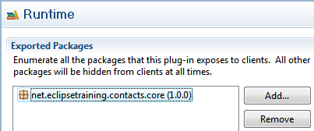
Declaring the public API (2)
Tip: Use the manifest editor to edit the exported packages!
Best practice:
Use “internal” for naming non-API packages, e.g.
“net.eclipsetraining.contacts.core.internal.somepackage”!

Slide 40
Declaring Bundle Dependencies (1)
A bundle has to declare its dependencies explicitly
One way is to declare dependent packages:
The manifest header Import-Package is used
All listed packages are made available for the bundle
Packages are separated by comma
A package version or version range may be used
A package can be required optionally
Import-Package:
net.eclipsetraining.contacts.core;version="[1.0.0,2.0.0)"

Slide 41
Declaring Bundle Dependencies (2)
Another way is to declare required bundles:
The manifest header Require-Bundle is used
All exported packages from the listed bundles are made available
Bundles are separated by comma
A bundle version or version range can be used
A bundle can be required optionally
Require-Bundle: org.eclipse.core.runtime;bundle-version="3.4.0",
org.eclipse.ui;bundle-version="3.4.0"

Slide 42
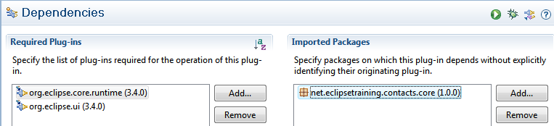
Declaring Bundle Dependencies (3)
Tip: Use the manifest editor to edit the dependencies!
Best practice:
Prefer Import-Package!
Use Require-Bundle only for Eclipse bundles!

Slide 43
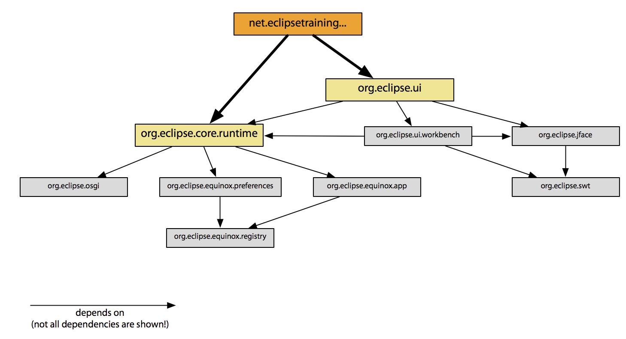
Bundle Dependency Graph

Slide 44
How does the Bundle Life Cycle look like?
All bundle states are entered through explicit life cycle operations:
Install, start, stop, uninstall and update
Except for RESOLVED: Resolving is up to the OSGi framework
install
update
uninstall
INSTALLED
STARTING
update
start
update
RESOLVED
ACTIVE
uninstall
stop
UNINSTALLED
STOPPING

Slide 45
Task 1: Create a Business Logic Plug-in (1)
Step 1: Create a new plug-in project
Project name: net.eclipsetraining.contacts.core
Do not generate an Activator (uncheck)
Do not contribute to the UI (uncheck)
Do not create a rich client application
Do not use any templates
Step 2: Create a new Java bean class for Contact:
Package: net.eclipsetraining.contacts.core (like plug-in name)
Class name: Contact
String properties: firstName, lastName, street, city, zip, state, country, phone, email

Slide 46
Task 1: Create a Business Logic Plug-in (2)
Step 3: Create an interface for Contacts manager
Package: net.eclipsetraining.contacts.core
Interface name: IContactsRepository
Methods:
void addContact(Contact)
void removeContact(Contact)
Collection<Contact> getAllContacts()
Step 4: Export the package net.eclipsetraining.contacts.core
Set the package version to 1.0.0

Slide 47
Task 2: Implement the Business Logic (1)
Step 1: Create a new class DummyContactsRepository
Package: net.eclipsetraining.contacts.core.internal
Implement IContactsRepository backed by a Collection <Contact> initialized with one (or more) dummy Contact(s)
public class DummyContactsRepository implements IContactsRepository {
private final Collection<Contact> contacts = ...
public DummyContactsRepository() {
Contact contact = new Contact();
...
contacts.add(contact);
}
public void addContact(final Contact contact) {
contacts.add(contact);
}
...

Slide 48
Task 2: Implement the Business Logic (2)
Step 2: Create a new class ContactsRepositoryFactory
Package: net.eclipsetraining.contacts.core
Method getContactsRepository() returning a static member of type DummyContactsRepository:
public class ContactsRepositoryFactory {
private static final IContactsRepository CONTACTS_REPOSITORY =
new DummyContactsRepository();
public static IContactsRepository getContactsRepository() {
return CONTACTS_REPOSITORY;
}
...

Slide 49
Task 3: Create a client Plug-in (1)
Step 1: Create a new plug-in project
Project name: net.eclipsetraining.contacts.client
Target it to run with OSGi Framework: Equinox
Do generate an Activator (check): net.eclipsetraining.contacts.client.internal.Activator
Step 2: Add dependencies:
Import-Package for org.osgi.framework is already there
Declare Import-Package for net.eclipsetraining.contacts.core
Use a version range from 1.0.0 (inclusive) till 2.0.0 (exclusive)
Step 3: Test with different (non-matching) versions and version ranges

Slide 50
Task 3: Create a client Plug-in (2)
Step 3: Implement client’s bundle Activator
Extend method #start() of net.eclipsetraining.contacts.client.internal.Activator
Use ContactsRepositoryFactory to get an instance of IContactsRepository
Iterate over all contacts and print their names to the console
Step 4: Create a new “OSGi framework” run configuration:
“Deselect All” bundles, add all the two bundles from workspace and press “Validate Plug-ins”
Press “Add Required Bundles” and “Validate Plug-ins” again
Run and look at the console output

Slide 51
Optional Tasks
Experiment with the OSGi console:
Start the application with –console argument
Run with “Default Auto-Start” false:
Enter “ss” and find the bundle ID for net.eclipsetraining.contacts.client
Enter “start <ID>”

Slide 52
What does the Bundle Life Cycle mean to RCP?
Modularity at runtime through installing and uninstalling
Bundles can be “used” as soon as they are RESOLVED:
No need to activate a bundle in order to use the API
Take care of activators (BundleActivator):
BundleActivators are internal: Do not export!
start()- and stop()-methods must return fast!
Don’t create a activator if you don’t need one
Activation is mainly used for OSGi services:
Very promising, but not yet very prominent in RCP

Slide 53
How many Plug-ins do we need?
Or: When will you create a new plug-in?
There is no simple answer, but some guidelines:
Separate optional functionality, i.e. something that can be added or taken away
Create a plug-in for common and reusable base functionality
Package third-party libraries into their own plug-ins
Separate different concerns (strata rule), e.g. business and UI code
Think about separating API from implementation

Slide 54
Agenda
Introduction
“Hello world!“ the RCP Way
RCP from 10000 Feet
OSGi and Plug-ins
The Workbench
Using Extension Points
RCP Applications
Products and Branding
Views
SWT Basics
JFace Standard Dialogs
JFace Viewers
The Selection Service
Commands
Wizards
Editors
i18n
Testing RCP with JUnit

Slide 55
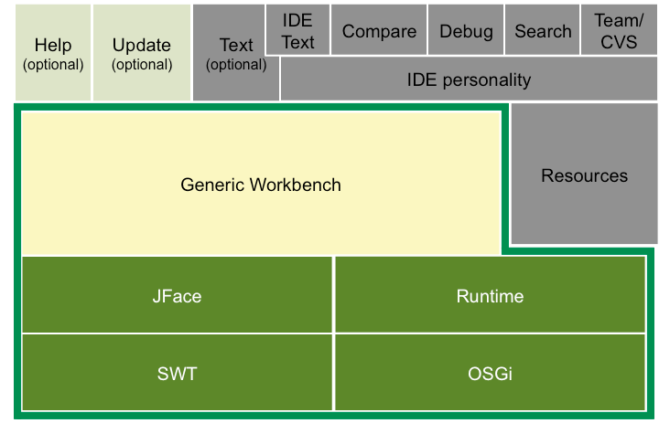
High-level RCP Architecture

Slide 56
Workbench
Workbench is the entry point for most APIs, implements the IWorkbench Interface.
Access it via PlatformUI.getWorkbench()
Provides access to important parts of the platform, as to
Workbench Windows
Active Workbench Window
Registries (Editors, Views, Perspectives, etc.)
Help
Preference Manager
…
Provides several methods for controlling:
close()
restart()
saveAllEditors()
…

Slide 57
The Workbench Window

Slide 58
How can the Workbench be configured?
The workbench is created internally by RCP
You can advise this process with:
WorkbenchAdvisor
WorkbenchWindowAdvisor
ActionBarAdvisor

Slide 59
The Workbench Advisor ...
... defines the default perspective for the workbench:
... activates the save-and-restore behavior of the workbench:
Window size, position etc. are restored on reopening
The data is persisted between sessions in the applcation’s workspace data dir (see in run configuration, „Main“ tab)
@Override
public String getInitialWindowPerspectiveId() { ...
@Override
public void initialize(final IWorkbenchConfigurer configurer) {
super.initialize(configurer);
configurer.setSaveAndRestore(true);
}

Slide 60
The Workbench Window Advisor ...
... configures the workbench window:
Window size
Window title
Visibility of menu bar, toolbars, status bar etc.
@Override
public void preWindowOpen() {
getWindowConfigurer().setInitialSize(new Point(400, 300));
getWindowConfigurer().setShowCoolBar(false);
getWindowConfigurer().setShowStatusLine(false);
getWindowConfigurer().setTitle("Contacts");
}

Slide 61
Action Bar Advisor
The ActionBar Advisor is responsible for configuring the Action Bars of the application:
CoolBar
MenuBar
StatusBar
To do it you may override:
makeActions(IWorkbenchWindow)
fillCoolBar(ICoolBarManager)
fillMenuBar(IMenuBarManager)
fillStatusLine(IStatusLineManager)
For creating standard Workbench actions and items the following factories are used:
org.eclipse.ui.actions.ActionFactory
org.eclipse.ui.actions.ContributionItemFactory

Slide 62
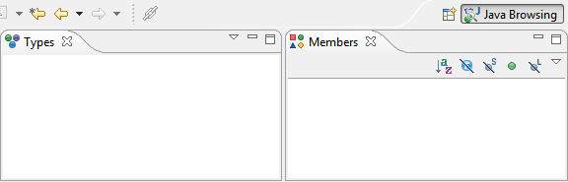
What is a Perspective?
A Perspective arranges workbench parts (Views and Editors)
Perspectives are typically used for "bundling" of role-specific functionalities, e.g. end user mode, administration mode etc.
Perspectives can optionally be switched by the user
There has to be a default perspective!

Slide 63
Further Information
Article “Inside the Workbench” by Stefan Xenos

Slide 64
Agenda
Introduction
“Hello world!“ the RCP Way
RCP from 10000 Feet
OSGi and Plug-ins
The Workbench
Using Extension Points
RCP Applications
Products and Branding
Views
SWT Basics
JFace Standard Dialogs
JFace Viewers
The Selection Service
Commands
Wizards
Editors
i18n
Testing RCP with JUnit

Slide 65
High-level RCP Architecture

Slide 66
What are Extension Points and Extensions?
Extension points let a plug-in be extended by new functionality, e.g.:
Menus (UI)
File types (editors)
Products, own business domain classes etc.
New functionality is contributed by extensions
Plug-ins declaring extension points are called enablers, these declaring extensions are called extenders
Ext. point
Extender
Enabler

Slide 67
Background: The Extension Registry
Extension points and extensions are declared in the plug-in manifest (plugin.xml)
The extension registry scans the declarations on startup
Extensions are matched to extension points
Only declarative information is used, no classes are loaded so far
Sometime the enabler queries the extension registry for extensions:
The extenders' declarative information is used, e.g. menu labels
If needed, the extender(s) is/are asked for an executable extension (Java class) and program flow is delegated to the extender(s)
Ext. point
Extender
use
Enabler
call

Slide 68
Contributing Extensions (1)
Extensions are declared in the plug-in manifest (plugin.xml):
The extension-element is used
Extension points are referenced by ID and namespace
Extensions have to stick to the given extension point schema
<extension id="application"
point="org.eclipse.core.runtime.applications">
<application>
<run
class="net...application.internal.application.Application">
</run>
</application>
</extension>

Slide 69
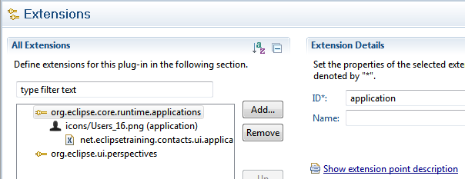
Contributing Extensions (2)
The PDE tooling for plugin.xml is providing an “Extensions” tab for displaying and editing the extensions:

Slide 70
Contributable Workbench Window components
Action Bars (Menus, Toolbars, Actions)
Status line (IContributionItem)
Views, Editors, Perspectives
Parts Action Bars
Wizards (New-, Export-, Import-)
Key bindings
Intros
Preference pages
…and many more

Slide 71
Task: Look at the Extension Point Reference
Dozens of extension points are provided by the Eclipse platform
Go to the Eclipse Help (Manu Help / Help Contents) and get an overview at: “Platform Plug-in Developer Guide > Reference > Extension Points Reference”
Take a deeper look at one important extension point: org.eclipse.ui.views

Slide 72
Further Information
Book “Contributing to Eclipse” by Erich Gamma and Kent Beck
Article “A Comparison of Eclipse Extensions and OSGi Services” by Neil Bartlett

Slide 73
Agenda
Introduction
“Hello world!“ the RCP Way
RCP from 10000 Feet
OSGi and Plug-ins
The Workbench
Using Extension Points
RCP Applications
Products and Branding
Views
SWT Basics
JFace Standard Dialogs
JFace Viewers
The Selection Service
Commands
Wizards
Editors
i18n
Testing RCP with JUnit

Slide 74
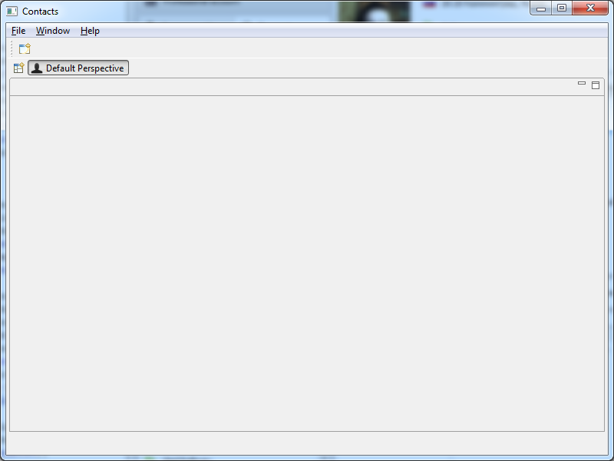
Lab #02 Objective: Start and configure RCP app

Slide 75
The Entry Point for Applications ...
... is provided by the extension point org.eclipse.core. runtime.applications:
The “id” attribute names the application
The “class” attribute provides an IApplication-implementation
<extension id="application"
point="org.eclipse.core.runtime.applications">
<application>
<run
class="net...application.internal.application.Application">
</run>
</application>
</extension>

Slide 76
The Application Class ...
... creates the workbench
... must implement IApplication:
public class Application implements IApplication {
public Object start(final IApplicationContext context){
final Display display = PlatformUI.createDisplay();
try {
final int returnCode = PlatformUI.createAndRunWorkbench(
display, new ApplicationWorkbenchAdvisor());
if (returnCode == PlatformUI.RETURN_RESTART)
return IApplication.EXIT_RESTART;
return IApplication.EXIT_OK;
} finally {
display.dispose();
}
}
public void stop() { ...

Slide 77
Task: Create an RCP Application (1)
Step 1: Create a new plug-in
Name: net.eclipsetraining.contacts.ui.application
Do contribute to the UI (check)
This automatically adds dependencies to org.eclipse.core.runtime and org.eclipse.ui
Do create a rich client application (check)
Use the “Hello RCP” template
Application window title: “Contacts”
Inspect the plug-in manifest and the generated classes:
MANIFEST.MF
plugin.xml
Application
*Advisor
*Perspective

Slide 78
Task: Create an RCP Application (1)
Step 2: Customize the generated plug-in
Change the name attribute of the perspective to “Default Perspective”
Apply the necessary changes in order to save the workbench state (see slides of previous chapter “The Workbench”)
Step 3: Create initial menu structure
Use ApplicationActionBarAdvisor class methods
Use these two factories for standard actions and items:
org.eclipse.ui.actions.ActionFactory
org.eclipse.ui.actions.ContributionItemFactory

Slide 79
Task: Create an RCP Application (2)
Step 4: Create and configure the run configuration
In the manifest editor click the icon or the link “Launch an Eclipse application”
Open the “Run configurations ...” menu and select the current run configuration
Uncheck a plug-in of the target platform on the “Plug-ins” tab and press “Run”
Observe the error and fix it by clicking “Add required Plug-ins“
Save the fixed run configuration: “Common tab” / “Save as” / “Shared file”, select the project net.eclipsetraining.contacts.ui.application

Slide 80
Task: Create an RCP Application (3)
Step 5: Clearing workspace data directory
The workspace data directory holds the application’s workbench state of previous sessions
You can clear this directory before launching an application
See “Workspace Data” on the “Main” tab of the launch configuration
Check the effects on workbench state when reopening the application (e.g. change the size of the workbench window)
Hint: make sure that the workbench save-and-restore behavior is enabled (see previous chapter; slide “The Workbench Advisor…”)

Slide 81
Optional Tasks
Modify the WorkbenchWindowAdvisor in order to:
Change the window title
Change the window size
Try some refactorings, e.g. rename the class Perspective into DefaultPerspective
Try various refactoring options and check the result: Is the application still running? If not, why?
Try to create a run configuration from scratch

Slide 82
Agenda
Introduction
“Hello world!“ the RCP Way
RCP from 10000 Feet
OSGi and Plug-ins
The Workbench
Using Extension Points
RCP Applications
Products and Branding
Views
SWT Basics
JFace Standard Dialogs
JFace Viewers
The Selection Service
Commands
Wizards
Editors
i18n
Testing RCP with JUnit

Slide 83
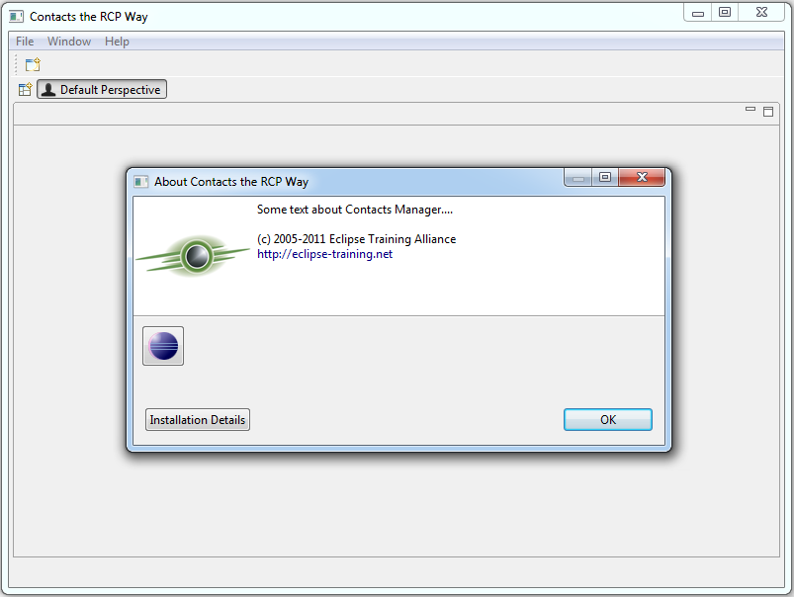
Lab #03 Objective: configure and export Product

Slide 84
An Eclipse Product ...
... is a standalone program built with Eclipse RCP
Application plug-ins
Necessary RCP plug-ins
Optionally a Java runtime environment
... can be branded individually
Labels: Window title, launcher name
Icons: Window title bar, launcher, application window, task bar
Splash screen
About image and text
...

Slide 85
A Product is defined ...
... through the extension point org.eclipse.core.runtime. products
A product always references an application.
This information is used at runtime!
<extension id="product“
point="org.eclipse.core.runtime.products">
<product
application="net...application.application“
name="Contacts the RCP Way">
<property name="appName“
value="Contacts the RCP Way">
</property>
</product>
</extension>

Slide 86
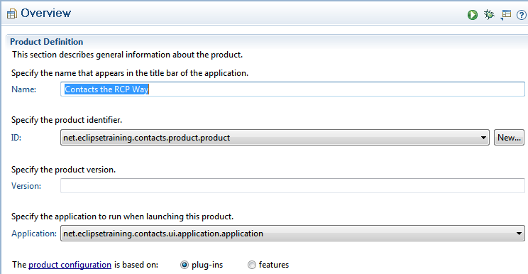
A Product is configured ...
... through a product configuration file: <NAME>.product

Slide 87
Product Configuration Overview
Information for the extension:
Product and application ID
Product name
Lists all plug-ins the product consists of
Configures launching:
Launcher name and icon
Launching and JVM arguments
Optionally specifies a JRE to be packaged and used
Branding:
Splash screen
Window images
About dialog
...

Slide 88
Products wrapped up
The product configuration can be placed “anywhere”:
Only used by PDE and PDE build
No need to be exported (build.xml)
The product extension has to be defined in a plug-in manifest (plugin.xml)
Tip: Do not edit the product extension manually! Synchronize it from the product configuration
Hint:
If you want to provide different brandings of
your application create an extra plug-in
per product.

Slide 89
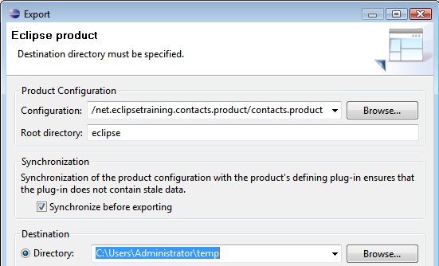
Exporting a Product ...
... is supported through the product export wizard:

Slide 90
Task: Create a Product (1)
Step 1: Create a new plug-in for the product
Name: net.eclipsetraining.contacts.ui.product
Ster 2: Create a Feature
Name: net.eclipsetraining.contacts.feature
Include all relevant workspace plug-ins into the feature:
net.eclipsetraining.contacts.core
net.eclipsetraining.contacts.ui.application
net.eclipsetraining.contacts.ui.product
Step 3: Create a product configuration file
Select the product project and open the new Product Configuration wizard
File name: “contacts”
Select “Create … with basic settings”
Press “Finish”

Slide 91
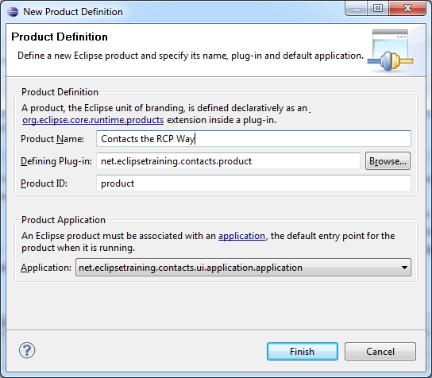
Task: Create a Product (2)
Step 4: Create a new Product Definition
Press Product Definition → New in the Product editor
Fill out the fields:

Slide 92
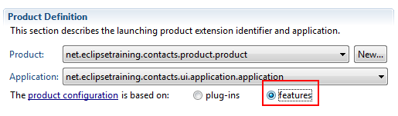
Task: Create a Product (3)
Step 5: Make sure your product is based on Features:
Step 6: Add Features into the Product (Tab “Dependencies”):
net.eclipsetraining.contacts.feature
org.eclipse.rcp
Step 7: Launch the product
Press “Synchronize” on the overview tab and “Launch an Eclipse application”
Step 8: Export the product
Use “Contacts” as “Root directory”

Slide 93
Optional Tasks
Apply some changes
Why is the window title still “Contacts”? Fix this to show “Contacts the RCP Way”
Set the launcher name to “Contacts”
Add a JRE to the product configuration:
Re-export the product
Inspect the exported product: Where is the JRE?
Add a splash screen (splash.bmp) to the product’s defining plug-in

Slide 94
Agenda
Introduction
“Hello world!“ the RCP Way
RCP from 10000 Feet
OSGi and Plug-ins
The Workbench
Using Extension Points
RCP Applications
Products and Branding
Views
SWT Basics
JFace Standard Dialogs
JFace Viewers
The Selection Service
Commands
Wizards
Editors
i18n
Testing RCP with JUnit

Slide 95
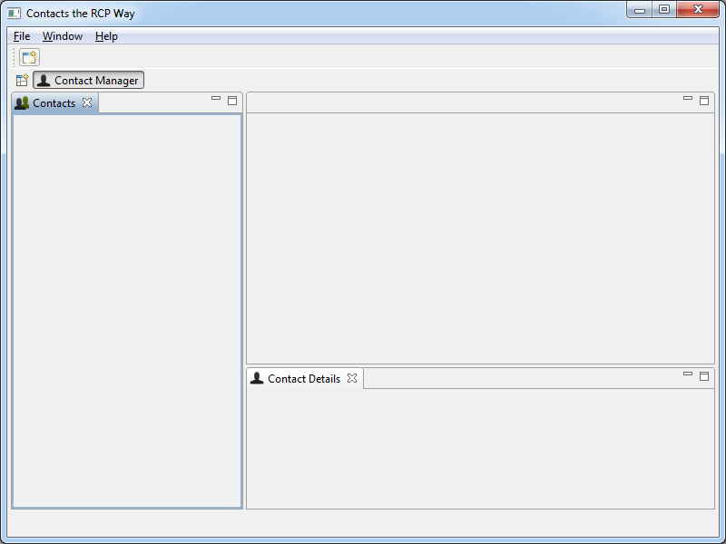
Lab #04 Objective: Contribute views

Slide 96
View Features (1)
Can be moved and docked “anywhere” on the workbench window
Can be stacked one over another:
Can have their own menu and toolbars:

Slide 97
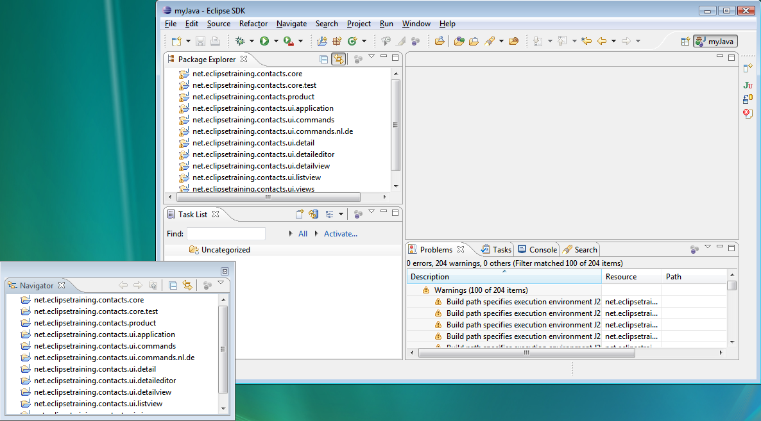
View Features (2)
Can be detached from the workbench window:

Slide 98
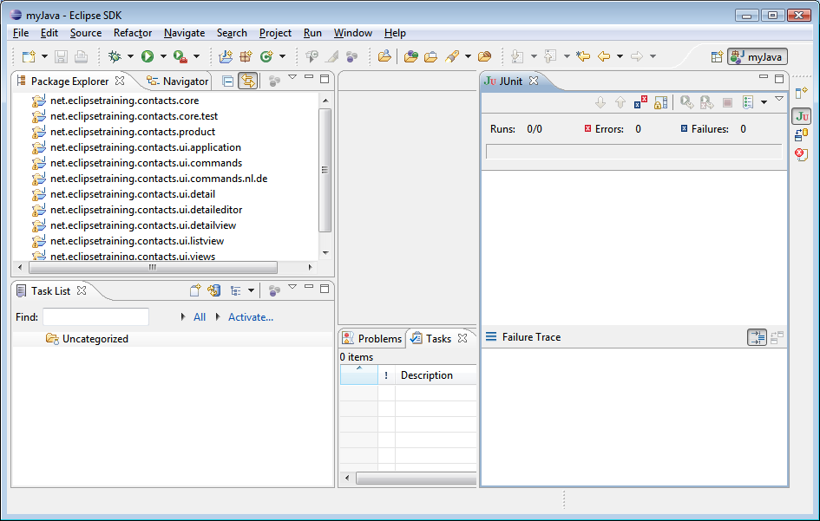
View Features (3)
Can be fast views:

Slide 99
Views are contributed ...
... through the extension point org.eclipse.ui.views:
The “class” attribute specifies an IViewPart-implementation
The “id” attribute is later used to reference the view
The “name” attribute defines the label shown in the workbench
<extension point="org.eclipse.ui.views">
<view
class="net...listview.internal.ListView"
id="net...listview.views.listview"
name="Contact List">
... >
</view>
</extension>

Slide 100
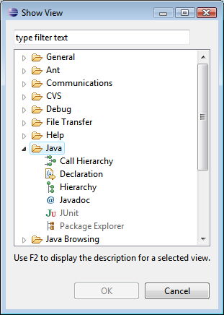
View Categories ...
... are used to group views, e.g. in the “Show View” menu
... are also contributed through the extension point org.eclipse.ui.views
<extension point="org.eclipse.ui.views">
<category
id="net...views.categories.contacts"
name="Contacts">
</category>
</extension>

Slide 101
View Implementations
Views have to implement IViewPart
Tip: Extend the base class ViewPart!
public class ListView extends ViewPart {
@Override
public void createPartControl(final Composite parent) {
...
}
@Override
public void setFocus() {
...
}

Slide 102
Task: Add a View to the Application (1)
Step 1: Contribute a view for a contact list
ID: net.eclipsetraining.contacts.ui.view.list
Name: “Contacts”
Class: extend ViewPart with empty method skeletons or trace output
Step 2: Contribute a perspective extension
Try to figure out the meaning and details by using the extension point description for org.eclipse.ui.perspectiveExtensions
Add the “Contacts” view to the default perspective
Place it to the left from the Editor Area id = org.eclipse.ui.editorss

Slide 103
Task: Add a View to the Application (2)
Step 4: Run the updated application
Take care to update the run configuration(s) correctly!
Try some of the view features, e.g. docking and detaching
Step 5: Create a “Contact Details” view
Add the “Contact Details” view to the default perspective
Place it to the bottom of the Editor Area
Optional: Contribute a view category: net.eclipsetraining.contacts.ui.contacts.category
Add your views to this category
Find a place in the Workbench where you may see this category

Slide 104
Agenda
Introduction
“Hello world!“ the RCP Way
RCP from 10000 Feet
OSGi and Plug-ins
The Workbench
Using Extension Points
RCP Applications
Products and Branding
Views
SWT Basics
JFace Standard Dialogs
JFace Viewers
The Selection Service
Commands
Wizards
Editors
i18n
Testing RCP with JUnit

Slide 105
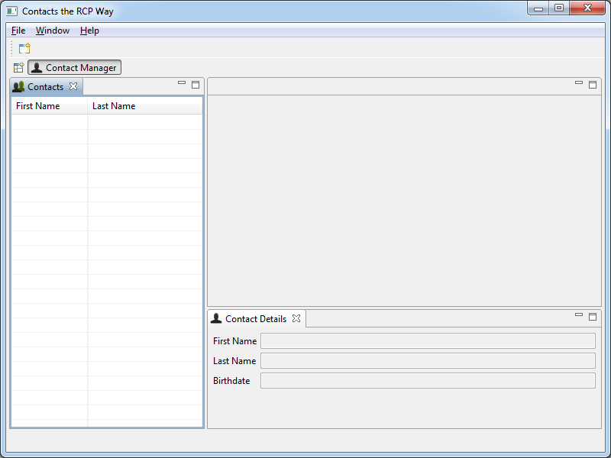
Lab #05 Objective: create an SWT UI form

Slide 106
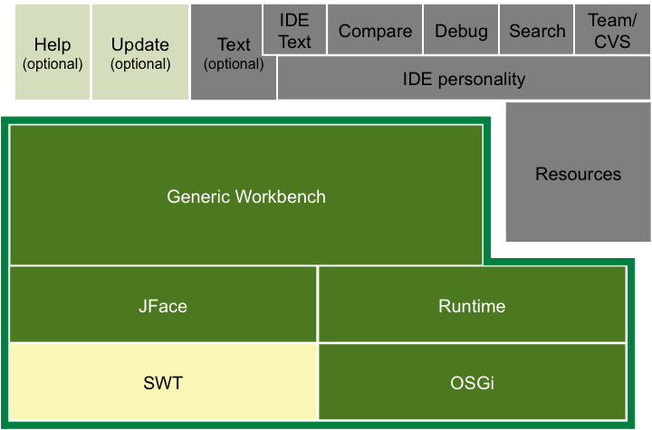
High-level RCP Architecture

Slide 107
What is SWT?
The Standard Widget Toolkit (SWT) is a widget toolkit for Java
SWT provides a portable API on all supported platforms
Native operating system widgets are used wherever possible:
MFC under Windows
GTK under Linux
Carbon under Mac
Missing operating functionality is emulated
SWT provides only a very raw, low level abstraction:
Model-based components similar to Swing are introduced in JFace

Slide 108
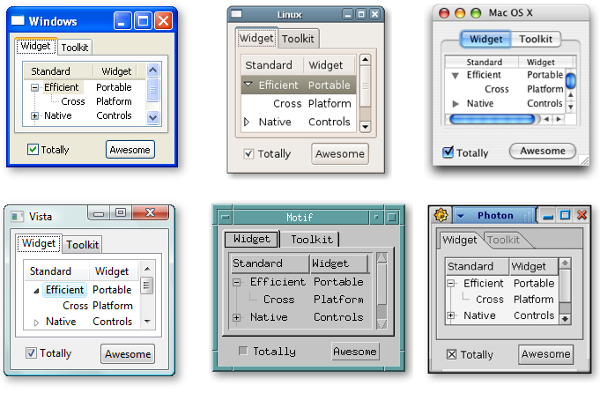
SWT on different Platforms

Slide 109
Pros and Cons of SWT
Advantages of SWT
Consistent native look and feel on each platform
Good performance
Easy to program
Criticism on SWT
Requires a native library
Platform dependent odds and ends: It is highly recommend to test on each platform you want to support with your application
Low level of abstraction
Endless discussions which UI framework is better: SWT or Swing

Slide 110
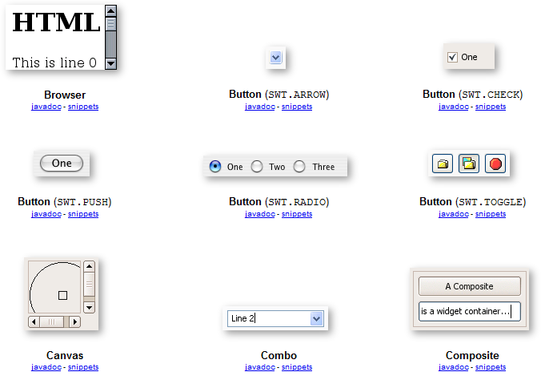
SWT Widgets (1)

Slide 111
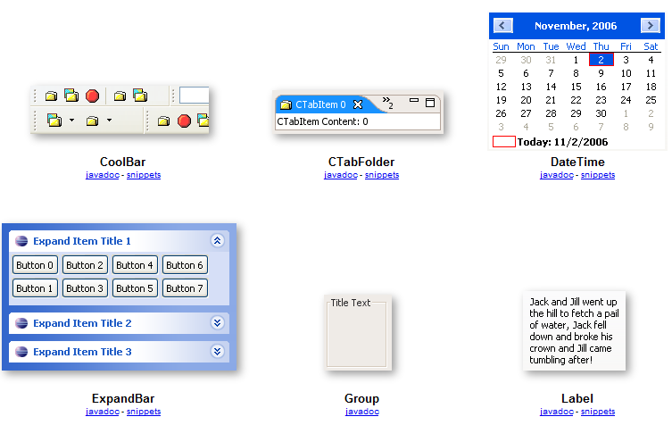
SWT Widgets (2)

Slide 112
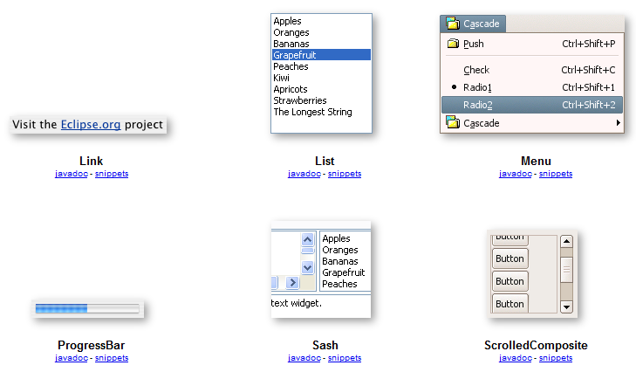
SWT Widgets (3)

Slide 113
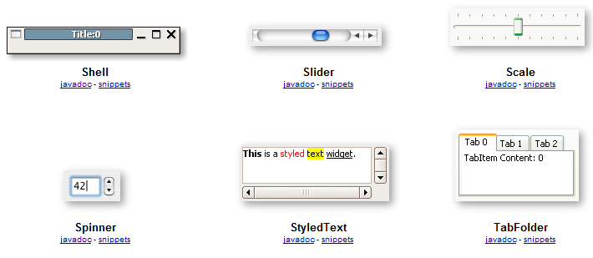
SWT Widgets (4)

Slide 114
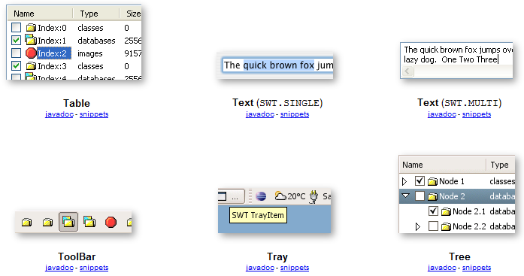
SWT Widgets (5)

Slide 115
Task: Look at the Controls in Eclipse Examples
Step 1: Install the Eclipse Examples
Unzip the eclipse-examples-3.5.1-win32.zip to the dropins folder of your Eclipse IDE installation
For Microsoft Windows: eclipse-examples-3.4-win32.zip
For other operating systems: eclipse-examples-3.4.zip
Restart your Eclipse IDE
Step 2: Browse some of the widgets
Open the “SWT Examples / SWT Controls” view
Look at Button, Text etc.

Slide 116
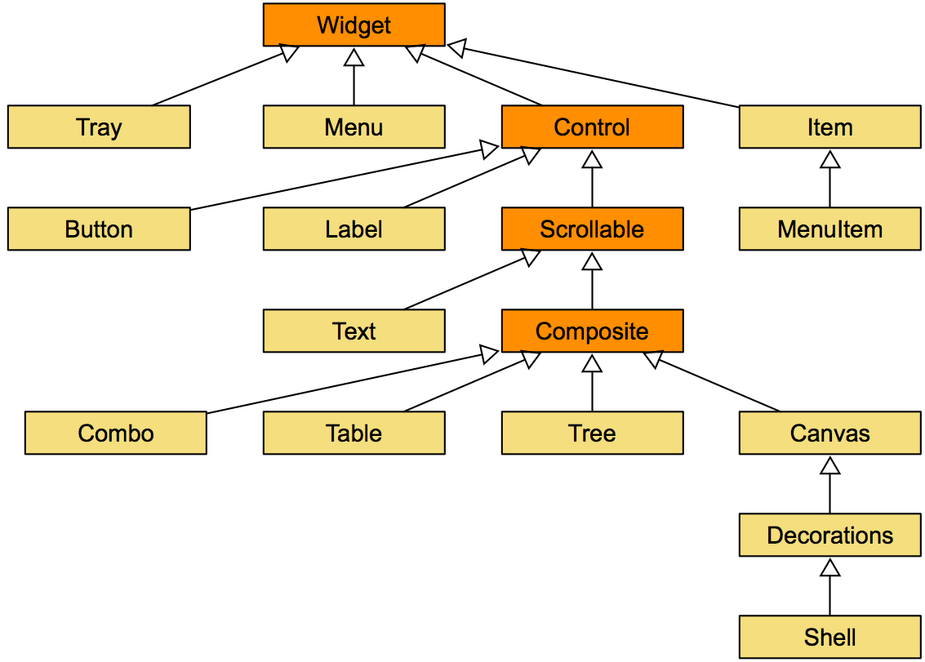
SWT Widget Hierarchy (1)

Slide 117
SWT Widget Hierarchy (2)
All widgets are arranged in a tree-like structure
Every widget except for a top-level shell has one widget as parent
The parent widget is passed to the control as constructor argument:
The second constructor argument is a style constant
Multiple style constants can be specified using the OR operator, e.g.
Most SWT classes are not intended to be subclassed!
new Text(parent, SWT.NONE)
SWT.MULTI | SWT.BORDER

Slide 118
The Widget Class ...
... is the superclass of all SWT user interface classes
... can be created
... receives notifications when events occur
... must be disposed

Slide 119
The Control Class ...
... is a direct subclass of the Widget class
... is the superclass of all SWT “windowed” user interface classes
... knows it's size and position
... can be enabled or disabled
... can be visible or invisible
... can receive keyboard focus
... can handle focus, mouse, keyboard, size, paint, ... events

Slide 120
The Composite Class ...
... is a special control that contains other controls
... manages it's child controls:
On disposal all children will be disposed recursively
Supports layouts to arrange the children

Slide 121
The Shell Class ...
... is special subclass of the Composite class and
... represents the “window concept” of the underlying windowing system
Top level shells do not have a parent
Parented shells are called secondary or dialog shells
There has to be at least one top level shell
In RCP the top level shell is created by the framework

Slide 122
The Display Class ...
... connects to the underlying windowing system
Most important task: Implement the SWT event loop
Each SWT program has to create a display
Usually a display is created at the very beginning of a SWT program
In RCP the display is created by the application class
In most cases only one display instance is needed per application
Some platforms allow only one active display

Slide 123
The SWT Event Loop
In SWT the application must create the event loop:
SWT controls must only be called from the user interface thread
while (!shell.isDisposed()) {
if (!display.readAndDispatch()) display.sleep();
}
void Display.syncExec(Runnable)
void Display.asyncExec(Runnable)

Slide 124
SWT Layouts (1)
By default SWT does not size or position it's controls:
Every new control has a size of zero, thus it is invisible
Applications may specify positions and sizes explicitly:
Alternatively, for composites a layout may be specified:
A layout class is responsible for sizing and positioning controls
SWT layouts are similar to layouts in AWT / Swing
Custom layouts are created by subclassing the abstract class Layout
void Control.setBounds(Rectangle)
void Control.setSize(Point)

Slide 125
SWT Layouts (2)
A layout controls the position and size of children in a composite:
Sizing and positioning of a control is advised through layout data
Each control can be assigned a layout data object
Layout data is used by the layout to customize the control’s arrangement
void Composite.setLayout(Layout)
void Control.setLayoutData(Object)

Slide 126
SWT Layouts (3)
SWT comes with the following layouts:
FillLayout: Very simple, distributes controls equally in a row or column
RowLayout: Like FillLayout plus wrapping, configuring and working with RowData layout data
GridLayout: Advanced layout based on a grid with powerful GridData layout data for the controls
FormLayout: Advanced layout, places controls in relation to other controls
StackLayout: Stacks all the controls one on top of the other and resizes all controls to have the same size

Slide 127
Task: Look at the Layouts in Eclipse Examples
Step 1: Open the “SWT Examples / SWT Controls” view
Step 2: Look at FillLayout and GridLayout

Slide 128
Task: Complete the Contact Details View
Add a Table and TableColumns to the “Contacts” view
Show columns for first and last name
Make column headings and grid visible
Create a form for some of the contact properties in the “Contact Details” view
Best practice: subclass a Composite
Use appropriate layout to arrange the controls as you wish

Slide 129
SWT Listeners
Typical SWT listeners which can be attached to a control are:
SelectionListener
KeyListener
MouseListener
ModifyListener
... (see org.eclipse.swt.events package)
For most listeners there are adapters, e.g.:
MouseListener → MouseAdapter
SelectionListener → SelectionAdapter

Slide 130
Further Information
SWT homepage
SWT snippets: Small and understandable programming examples
Articles “SWT: The Standard Widget Toolkit” by Steve Northover:
Part 1
Part 2
Article “Creating your own SWT Widgets” by Steve Northover and Carolyn MacLeod
Article “Adding Drag and Drop to an SWT Application” by Veronica Irvine
Article “Custom Drawing Table and Tree Items” by Grant Gayed

Slide 131
Agenda
Introduction
“Hello world!“ the RCP Way
RCP from 10000 Feet
OSGi and Plug-ins
The Workbench
Using Extension Points
RCP Applications
Products and Branding
Views
SWT Basics
JFace Standard Dialogs
JFace Viewers
The Selection Service
Commands
Wizards
Editors
i18n
Testing RCP with JUnit

Slide 132
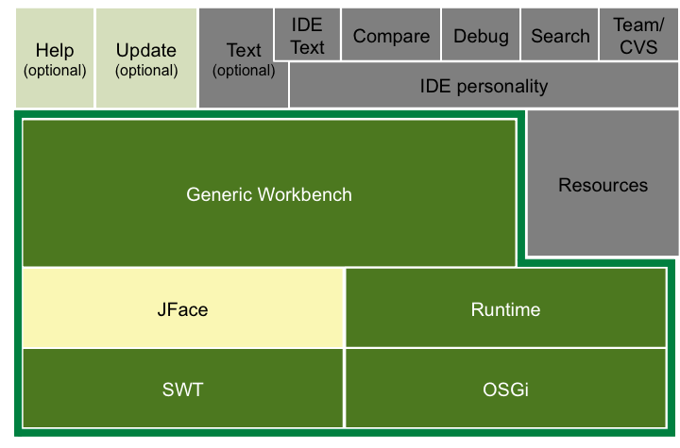
High-level RCP Architecture

Slide 133
What is JFace?
SWT does not deliver any common high-level UI concepts
JFace bridges this gap by providing:
Viewers for populating, sorting and filtering complex widgets
Registries for handling UI resources
Dialogs and wizards
...
JFace works on top of SWT, but does not hide it

Slide 134
Standard Dialogs
JFace provides standard dialogs for displaying user messages and obtaining simple input from the user:
Message dialog
Error dialog
Input dialog
...

Slide 135
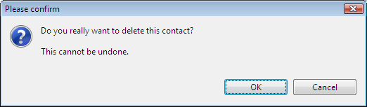
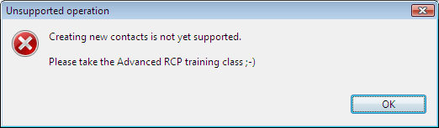
Message Dialog
MessageDialog.openConfirm(shell, "Please confirm",
"Do you really want to delete this contact?")
MessageDialog.openError(shell, "Unsupported operation",
"Creating new contacts is not yet supported ...")

Slide 136
Task: Try different types of Dialogs
Step 1: have a look at the example project
Plug-in: net.eclipsetraining.examples.dialogs
Class: ShowSWTMessageBoxHandler
Class: ShowJFaceMessageDialogHandler
(Optional) Try to create an own dialog
Hint: extend e.g. the org.eclipse.jface.dialogs.TitleAreaDialog

Slide 137
Agenda
Introduction
“Hello world!“ the RCP Way
RCP from 10000 Feet
OSGi and Plug-ins
The Workbench
Using Extension Points
RCP Applications
Products and Branding
Views
SWT Basics
JFace Standard Dialogs
JFace Viewers
The Selection Service
Commands
Wizards
Editors
i18n
Testing RCP with JUnit

Slide 138
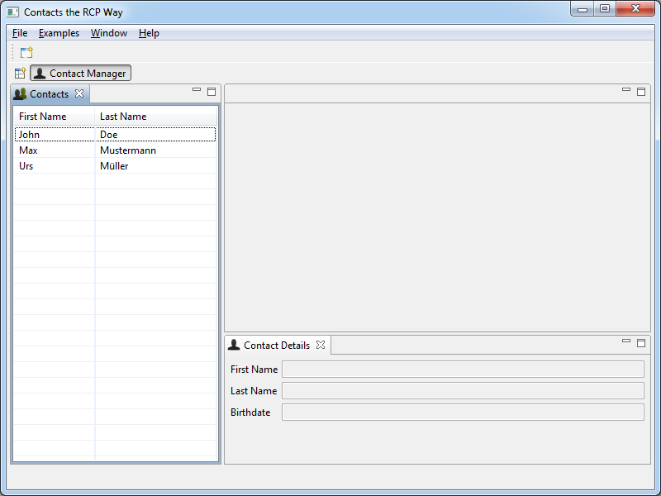
Lab #07 Objective: display the list of contacts

Slide 139
JFace Viewers ...
... are adapters from your domain model to the UI:
You can work with domain objects
Common widget-oriented tasks are handled by the viewers
... are provided for many non-trivial controls, e.g. table, tree, text, ...
... work on an input element:
Main object that is shown or edited
Changes of the input element are handled → Repopulate the control
Viewer
Input
Control

Slide 140
A Content Viewer ...
... delegates handling of input changes to a content provider:
The viewer queries the content provider for (an) element(s) to be shown
... delegates mapping the elements to be displayed to labels and images to a label provider
Content viewer
Content
provider
Input
Control
Label
provider

Slide 141
Structured Viewers ...
... allow for custom sorting and filtering by setting ...
... a viewer comparator (viewer sorter is deprecated)
... viewer filters
Implementations of structured viewers:
Combo viewer
List viewer
Table viewer
Tree viewer

Slide 142
The Table Viewer in Detail (1)
A table viewer wraps a SWT table
Use SWT.FULL_SELECTION in order to be able to fully select rows
Use Table.setHeaderVisible(true) in order to make column titles visible
Use Table.setLinesVisible(true) in order to make grid visible
A table viewer’s input typically is a collection or an array
Table viewer
Array
Table

Slide 143
The Table Viewer in Detail (2)
The content provider must implement IStructuredContent Provider
Each column has its own label provider extending ColumnLabelProvider (new since 3.3)
Table viewer
IStructuredContentProvider
Array
Table
ColumnLabelProvider

Slide 144
The Table Viewer in Detail (3)
Table viewer columns are created as children of the table viewer:
Use a TableColumnLayout to “beautify” the column layout
It must be applied to a composite only containing the (wrapped) table
Use ColumnWeightData to specify resizable columns using a relative width:
public TableViewerColumn(TableViewer viewer, int style)
tableColumnLayout.setColumnData(
firstNameColumn.getColumn(), new ColumnWeightData(40));

Slide 145
Task: Add a Table Viewer to the Application (1)
Step 1: Add and configure a table viewer to the “Contact List” view
Step 2: Fill the table viewer with data
Get all contacts from the core plug-in
Add an update()-method to the “Contact List” view which sets the new contacts

Slide 146
Optional Tasks
Sort the table viewer by last name using a viewer comparator
Make the columns moveable

Slide 147
Further Information
JFace Snippets: Small and understandable programming examples

Slide 148
Agenda
Introduction
“Hello world!“ the RCP Way
RCP from 10000 Feet
OSGi and Plug-ins
The Workbench
Using Extension Points
RCP Applications
Products and Branding
Views
SWT Basics
JFace Standard Dialogs
JFace Viewers
The Selection Service
Commands
Wizards
Editors
i18n
Testing RCP with JUnit

Slide 149
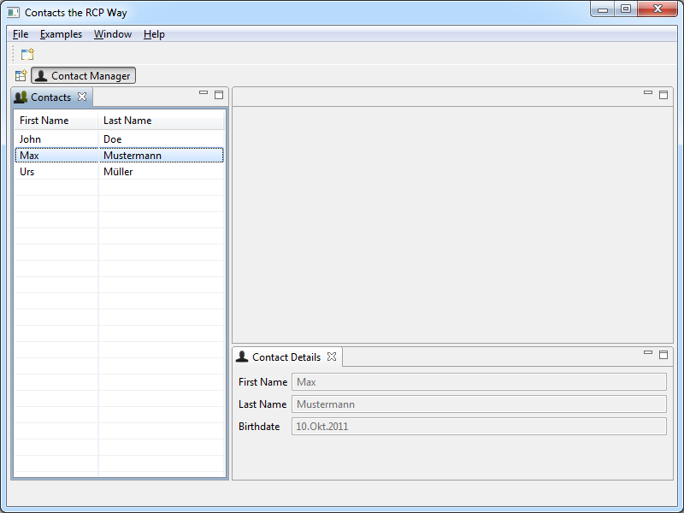
Lab #08 Objective: display selected contact details

Slide 150
Selections
The workbench window provides the concept of a "current selection"
Each workbench part can declare a selection
At any time there is only one current selection in a workbench window
Selections are generic: ISelection defines only one method
For specific types of content there are:
IStructuredSelection: A collection of elements
ITreeSelection: A selection containing tree paths
ITextSelection: A textual selection as range of characters
public boolean isEmpty()

Slide 151
The Selection Service
Workbench parts may provide a selection provider
Workbench part active → Current selection provided to selection service
Typically a JFace viewer is used as selection provider
Workbench parts may listen to selection change events
Workbench window
Selection service
Selection provider
Selection listener

Slide 152
Using the Selection Service
Use the workbench part site to specify a selection provider:
Get the selection service from the workbench window:
Register a selection listener with the selection service:
IWorkbenchPart.getSite().
setSelectionProvider(ISelectionProvider)
IWorkbenchPart.getSite().
getWorkbenchWindow().getSelectionService()
ISelectionService.addSelectionListener(ISelectionListener)

Slide 153
Task: Use the Selection Service
Step 1: Specify a selection provider
Use your TableViewer as selection provider for the “Contacts” view
Step 2: Register a selection listener ...
... in the “Contact Details” view
Update the text controls with the properties of the provided selection
(Optional)
Take care of “unselecting” as well

Slide 154
Further Information
See the Eclipse help for other workbench services:
Eclipse Help > Platform Plug-in Developer Guide > Programmer's Guide > Advanced workbench concepts > Services

Slide 155
Agenda
Introduction
“Hello world!“ the RCP Way
RCP from 10000 Feet
OSGi and Plug-ins
The Workbench
Using Extension Points
RCP Applications
Products and Branding
Views
SWT Basics
JFace Standard Dialogs
JFace Viewers
The Selection Service
Commands
Wizards
Editors
i18n
Testing RCP with JUnit

Slide 156
The History
Earlier there were Actions for contributing behavior:
Ext. points for global actions, view and editor actions and pop-up menus
Different types, e.g. IAction, IActionDelegate, IActionSet etc.
Actions do not separate concerns:
Visual representation like menus or toolbar icons
Execution of behavior → Code
Actions are still prominent
In the platform
In many examples and existing applications
Now there are commands!

Slide 157
The Present: Commands
The complete command framework was released in Eclipse 3.3:
Commands are concepts of behavior
Handlers concretize these abstractions
Menu contributions place commands into menus and toolbars
Commands may be associated with key bindings
Benefits:
Clean separation between representation and execution
Powerful declarative approach
Easy key binding

Slide 158
Commands are contributed ...
... through the extension point org.eclipse.ui.commands:
The “id” attribute is used to reference the command
The “name” attribute is used as default label in menu contributions
<extension
point="org.eclipse.ui.commands">
<command
id="net...commands.refreshcontacts"
name="Refresh Contacts">
</command>
</extension>

Slide 159
Workbench Commands
The workbench contributes a lot of commands, e.g.:
org.eclipse.ui.newWizard
org.eclipse.ui.help.aboutAction
org.eclipse.ui.edit.cut/copy/paste
These commands can be used in RCP applications
See the plug-in manifest (plugin.xml) of org.eclipse.ui for details

Slide 160
Menu Contributions
Extension point org.eclipse.ui.menus:
Contributions can be menus, toolbars, commands, separators etc.
The “locationURI” attribute specifies the location for the contribution
Possible location types: menu, popup, toolbar
The type has to be followed by an id, e.g. menu or view id
The exact placement can be defined with a “query part”:
Possible placements: before, after, endof (for separators)
<extension
point="org.eclipse.ui.menus">
<menuContribution
locationURI="menu:org.eclipse.ui.main.menu?after=window">
...
</menuContribution>
</extension>

Slide 161
Some important Location URI constants
menu:org.eclipse.ui.main.menu - the top-level menu
popup:org.eclipse.ui.popup.any - all pop-up menus
toolbar:org.eclipse.ui.main.toolbar - the top-level tool bar
toolbar:org.eclipse.ui.trim.command1 - the top left trim
toolbar:org.eclipse.ui.trim.command2 - the top right trim
toolbar:org.eclipse.ui.trim.vertical1 - the left vertical trim
toolbar:org.eclipse.ui.trim.vertical2 - the right vertical trim
toolbar:org.eclipse.ui.trim.status - the status line trim

Slide 162
Menu Contributions – Menus (1)
Menus are contributed through the “menu” sub-element:
The “id” attribute is used to reference the menu in location URIs
The “label” attribute is displayed
After doing so the new menu’s id net...menus.main.contact can be used as a location URI in other contributions
<extension point="org.eclipse.ui.menus">
<menuContribution
locationURI="menu:org.eclipse.ui.main.menu">
<menu
id="net...menus.main.contact"
label="Contact">
</menu>
</menuContribution>
</extension>

Slide 163
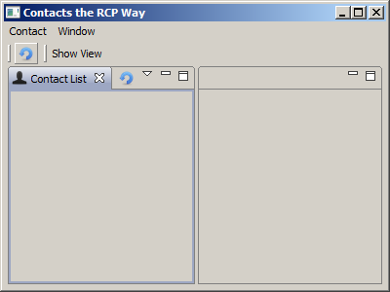
Menu Contributions – Menus (2)
Here you see the result of contributing the “Contact” labeled menu into menu:org.eclipse.ui.main.menu:

Slide 164
Menu Contributions - Toolbars
Toolbars are contributed through the “toolbar” sub-element:
The “id” attribute is used to reference the toolbar in location URIs
<extension point="org.eclipse.ui.menus">
<menuContribution
locationURI="toolbar:org.eclipse.ui.main.toolbar">
<toolbar
id="net...toolbars.main.contact">
</toolbar>
</menuContribution>
</extension>

Slide 165
Menu Contributions - Commands
Commands are placed into menus, pop-ups or toolbars through the “command” sub-element:
The “commandId” attribute references the command contribution
The “icon” attribute specifies an icon to be displayed
Possible styles: push, radio, toggle, pulldown
<extension point="org.eclipse.ui.menus">
<menuContribution
locationURI="menu:net....menus.main.contact">
<command
commandId="net...commands.refreshcontacts"
icon="icons/refresh_nav.gif"
style="push">
</command>
</menuContribution>
</extension>

Slide 166
Handlers are contributed ...
... through the extension point org.eclipse.ui.handlers:
The “class”-attribute specifies an IHandler-implementation
The “commandId”-attribute references an existing command
Tip: Extend AbstractHandler for your IHandler-implemen-tations!
<extension point="org.eclipse.ui.handlers">
<handler
class="net...commands.internal.RefreshContactsHandler"
commandId="net...commands.refreshcontacts">
</handler>
</extension>

Slide 167
Handler Activation (1)
Multiple handlers can be associated with the same command
Only one handler can be active at any time:
The active handler will be called for execution
Activation is configured through expressions:
<extension point="org.eclipse.ui.handlers">
<handler class="..." commandId="...">
<activeWhen>
<with
variable="activePartId">
<equals
value="net...listview.views.listview">
</equals>
</with>
</activeWhen>
...

Slide 168
Handler Activation (2)
No "activeWhen" condition makes a handler a default handler
Watch out for conflicts with explicitly defined default handlers!
The handler with the most "specific" expression is activated
This is based on evaluating the variables used in the expressions
The more "local" a variable, the more likely it will be active
Check ISources for variables and priorities
In case of equal priorities no handler will be activated!
Same for two default handlers

Slide 169
Task: create menus and toolbar items
Contribute actions (programmatically) and commands (declaratively) to all possible destinations:
Main Menu and Toolbar
Create a command of your choice and place it into the main bars
Make sure you can place your command wherever you want
View Menu and Toolbar
Create „Refresh Contacts“ command for the „Contacts“ view
Pop-up menu
Create „Delete Contact“ command for the „Contacts“ view
Editor Menu and Toolbar
This we may want to do later, since we don‘t have any Editor now…

Slide 170
Optional Tasks
Also contribute the “Refresh Contacts” command to the main toolbar
Also contribute the “Refresh Contacts” command to the “Contact List” view’s pop-up menu
Try to contribute some standard Workbench commands in the menu
Check the similarities with ActionFactory class

Slide 171
Further Information
Eclipse Wiki
wiki.eclipse.org/Platform_Command_Framework
wiki.eclipse.org/Command_Core_Expressions
wiki.eclipse.org/Menu_Contributions
wiki.eclipse.org/Menus_Extension_Mapping
See the Eclipse help
Eclipse Help > Platform Plug-in Developer Guide > Programmer's Guide > Plugging into the workbench > Basic workbench extension points using commands
Eclipse Help > Platform Plug-in Developer Guide > Reference > Extension Points Reference

Slide 172
Agenda
Introduction
“Hello world!“ the RCP Way
RCP from 10000 Feet
OSGi and Plug-ins
The Workbench
Using Extension Points
RCP Applications
Products and Branding
Views
SWT Basics
JFace Standard Dialogs
JFace Viewers
The Selection Service
Commands
Wizards
Editors
i18n
Testing RCP with JUnit

Slide 173
WizardDialog / Wizard
The Wizard API is provided by JFace
WizardDialog is a top level dialog for a wizard
It supports standard wizard buttons and controls the enablement of them
Your wizard class - implementing IWizard - controls overall behavior and logic of the wizard (title text and image, help button, etc.)
Typically you extend the Wizard class and
Create and add wizard pages using addPage(IWizardPage)
Implement the behavior that occurs when the user presses the finish button by overriding performFinish()

Slide 174
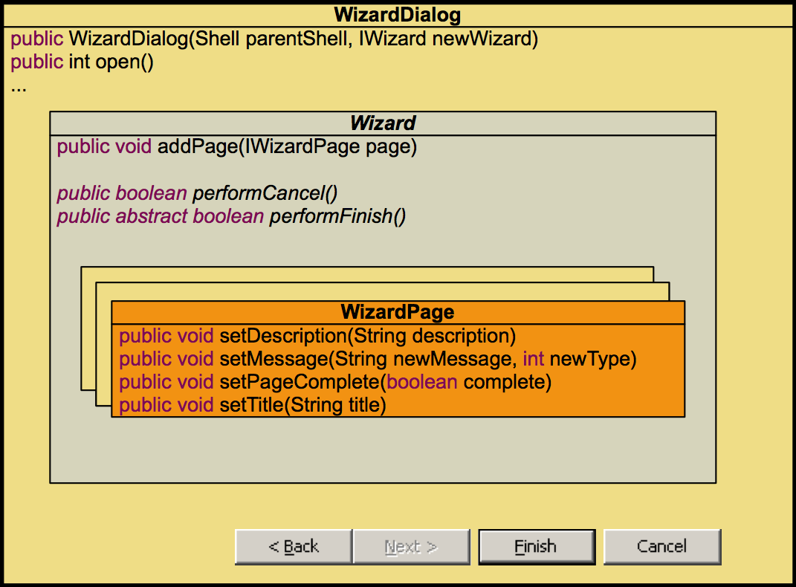
JFace Wizards API

Slide 175
Wizard Page I
Single pages are created by extending the WizardPage class
You need to override the createControl(Composite parent) method to create the content of the wizard page
Create a control that will hold your widgets and set it to the wizard page:
@Override
public void createControl(Composite parent) {
Composite cmp = new Composite(parent, SWT.NONE);
// add your widgets to the composite
…
setPageComplete(false);
setControl(cmp);
}

Slide 176
Wizard Page II
Your input widgets should be attached to a ModifyListener that
picks up user input,
calls your validation logic and
calls the framework method setPageComplete() to indicate whether the current page is complete:
@Override
public void createControl(Composite parent) {
…
final ModifyListener modifyListener = new ModifyListener() {
public void modifyText(ModifyEvent aE) {
setPageComplete(validateMyPage());
}
};
myTextWidget.addModifyListener(modifyListener);
…
}

Slide 177
Wizard Page III
Validation Errors can be indicated to the framework by calling setErrorMessage(String errorMessage):
The error messages will be shown in the WizardDialog
protected boolean validateMyPage() {
final boolean isComplete = … // your input validation here
if(!isComplete)
setErrorMessage(„Please provide more data!“);
else
setErrorMessage(null);
return isComplete;
}

Slide 178
Workbench Wizard Extension Points
The workbench defines three wizard related extension points:
org.eclipse.ui.newWizards
org.eclipse.ui.importWizards
org.eclipse.ui.exportWizards
You can contribute to these extension points and define your own wizard based operations for new, import and export functionality
If you contribute a wizard you need to provide your wizard implementation class
The WizardDialog itself is instantiated by the workbench

Slide 179
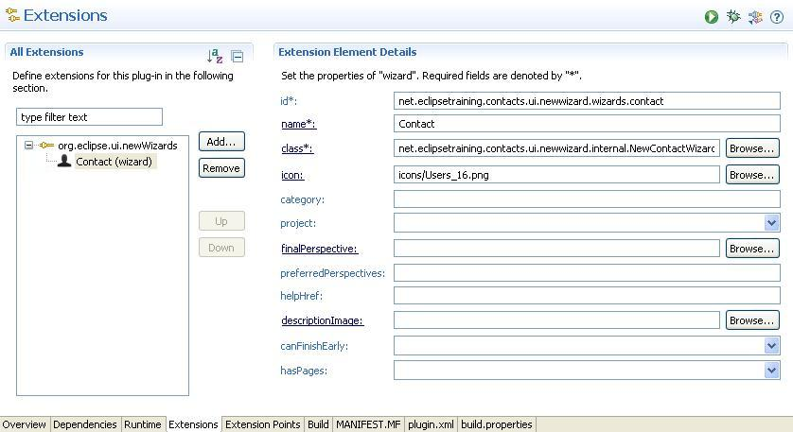
org.eclipse.ui.newWizards

Slide 180
Lab tasks I
Make sure the workbench’s "New" command is added in the main menu/toolbar of your application:
Use org.eclipse.ui.menu extension point for placement
Use this command id: org.eclipse.ui.newWizard
Add an extension to org.eclipse.ui.newWizards and contribute your wizard
Use the extension editor to create a class for your wizard

Slide 181
Lab tasks II
Create a wizard page class extending org.eclipse.jface. wizard.WizardPage and add it to your wizard
Add widgets to your page in order to gather the user‘s input
Implement the performFinish() method of your wizard
Retrieve the data entered on the page
Create a new contact by calling addContact(Contact)of the ContactsRepository
Make your WizardPage react if data is invalid:
Warn the user with a message and prevent the wizard from being finished.

Slide 182
Agenda
Introduction
“Hello world!“ the RCP Way
RCP from 10000 Feet
OSGi and Plug-ins
The Workbench
Using Extension Points
RCP Applications
Products and Branding
Views
SWT Basics
JFace Standard Dialogs
JFace Viewers
The Selection Service
Commands
Wizards
Editors
i18n
Testing RCP with JUnit

Slide 183
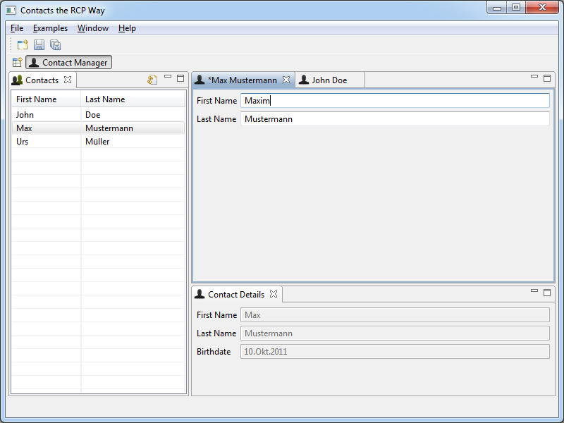
Lab #11 Objective: implement a contact editor

Slide 184
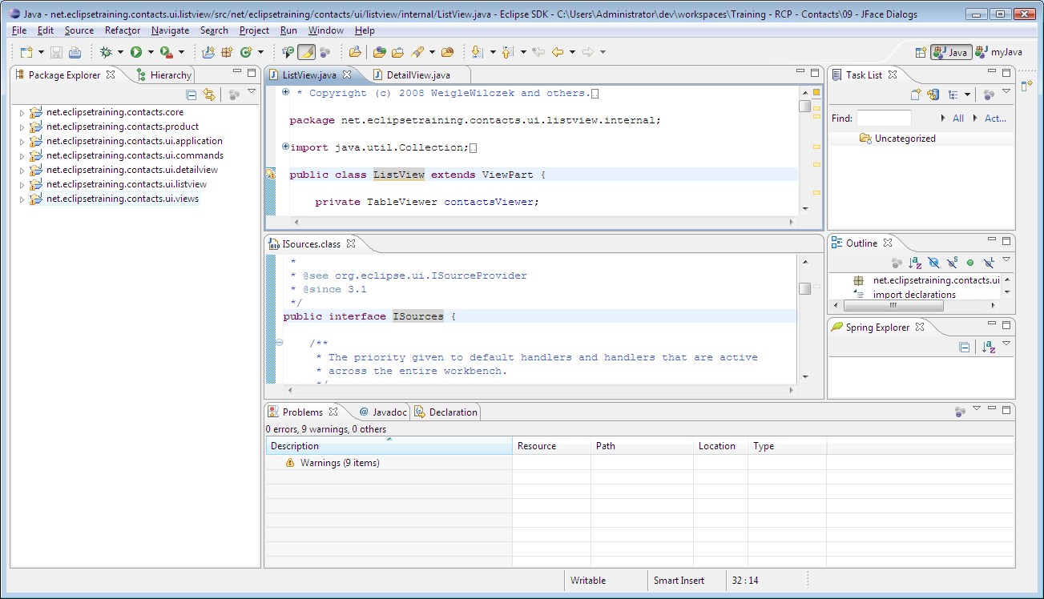
Editor Features (1)
Editors are always displayed in the editor area
Within this area they can be moved, docked and stacked
They cannot be moved “anywhere” on the workbench window like views

Slide 185
Editor Features (2)
Cannot be detached from the workbench window
Contribute to the main menu and toolbars
Are used in an “open-edit-save” style:
Implement ISaveablePart by default
If their content changes, editors are marked dirty:
For dirty editors the global “save”- and “save-as”-actions are enabled
Note: ISaveablePart may also be implemented by views!

Slide 186
Editors are contributed ...
... through the extension point org.eclipse.ui.editors:
The “class” attribute specifies an IEditorPart-implementation
The “id” attribute is used to reference the editor
The “name” attribute defines the label shown in the workbench
Tip: Extend the base class EditorPart!
<extension point="org.eclipse.ui.editors">
<editor
class="net...detaileditor.internal.DetailEditor"
id="net...detaileditor.editors.detail"
name="Contact Details Editor"
...>
</editor>
</extension>

Slide 187
Editors are opened ...
... through the workbench page:
An editor input is a lightweight descriptor for some content to be edited
Can be compared to java.io.File
The implementation typically contains:
A description of the content to be edited (IEditorInput methods)
A reference to the content to be edited
IWorkbenchPage.openEditor(IEditorInput, “editor.id”)

Slide 188
The dirty State
If an editor is dirty ...
... it is visually marked:
... the save-actions are enabled:
The editor has to notify the workbench that it might be dirty:
The workbench checks the dirty state by calling:
WorkbenchPart.firePropertyChange(ISaveablePart.PROP_DIRTY)
boolean isDirty()

Slide 189
Task: Add an Editor to the Application (1)
Step 1: Create a new plug-in for the editor
Name: net.eclipsetraining.contacts.detaileditor
Step 2: Contribute an editor
Name: “Contact Details Editor”
Implement an editor input wrapping a contact

Slide 190
Task: Add an Editor to the Application (2)
Step 3: Contribute an “Edit Contact”-command
Contribute this command to menu, toolbar or pop-up of the “Contacts List” view
Contribute a handler:
Only active for non-empty selections
Opens the “Contact Details” editor initialized with the selected contact from the DetailView

Slide 191
Task: Add an Editor to the Application (3)
Step 4: Contribute the global save-action
Contribute the command to the the “Contact” menu (and to the “Contact” toolbar, if previous optional task was completed successfully)
Attention: There is still “action-legacy”! In your ActionBarAdvisor implement makeActions() like this:
@Override
protected void makeActions(IWorkbenchWindow window) {
// This is NOT nice: Still need an action-handler bridge!
final IWorkbenchAction saveAction =
ActionFactory.SAVE.create(window);
register(saveAction);
}

Slide 192
Agenda
Introduction
“Hello world!“ the RCP Way
RCP from 10000 Feet
OSGi and Plug-ins
The Workbench
Using Extension Points
RCP Applications
Products and Branding
Views
SWT Basics
JFace Standard Dialogs
JFace Viewers
The Selection Service
Commands
Wizards
Editors
i18n
Testing RCP with JUnit

Slide 193
What means i18n (for RCP)?
Internationalization ...
... is a long word: i18n is shorter ;-)
... makes software adaptable to different languages and regions
For RCP there are three main areas of interest:
Java classes, e.g. messages
MAINIFEST.MF and plugin.xml manifest files, e.g. menu labels
Loacle-dependent resources, e.g. images

Slide 194
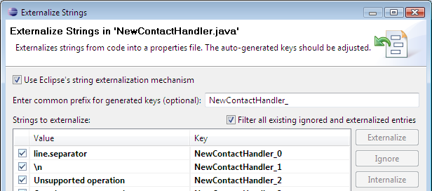
i18n of Java Classes ...
... works as in every Java program: ResourceBundles
JDT supports i18n through an “Externalize Strings” wizard

Slide 195
Externalize Strings “the Eclipse Way” ...
... creates a messages.properties file with keys and values:
... creates an accessor class Messages with static fields:
... and replaces the strings with accessor calls:
NewContactHandler_ADV_RCP_TRAINING=Please take the Advanced ...
...
class Messages extends NLS {
public static String NewContactHandler_ADV_RCP_TRAINING;
...
MessageDialog.openError(HandlerUtil.getActiveShell(event),
Messages.NewContactHandler_UNSUPP_OP,
Messages.NewContactHandler_CREATING_NEW_CONTACTS_NOT_SUPP
+ LINE_SEPARATOR + LINE_SEPARATOR
+ Messages.NewContactHandler_ADV_RCP_TRAINING);

Slide 196
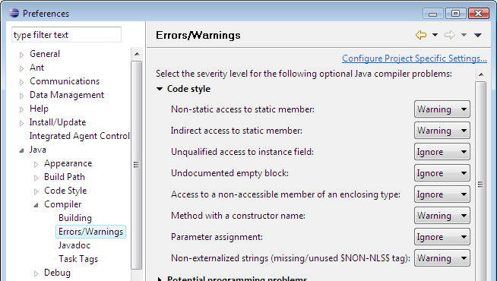
Externalize Strings
Tip: Let Eclipse tell you about non-externalized Strings in Java classes! Just configure the compiler accordingly:

Slide 197
i18n of Manifest Files (1)
In the bundle and plug-in manifests there are a lot of strings to be externalized, e.g.:
Bundle name
Command names
Menu labels
View and editor names
...
These strings can also be externalized into properties files
In the manifest files keys are prefixed with “%”, e.g. “Bundle-Name: %Bundle-Name.0”
The manifest header Bundle-Localization specifies the name of the properties file (no suffix!), e.g. “Bundle-Localization: plugin”

Slide 198

i18n of Manifest Files (2)
PDE supports i18n of plug-ins through another “Externalize Strings” wizard

Slide 199

i18n of Manifest Files (3)
Tip: Let Eclipse tell you about non-externalized Strings in manifest files! Just configure the PDE compiler accordingly:

Slide 200
Fragment Bundles
Fragment bundles are not autonomous, but attached to host bundles:
During resolving fragments become part of the host
They enhance the host, overwriting is not possible
Typical usage:
Add platform-specific content, e.g. for operating or window system
Add locale-specific content, e.g. localized properties
JUnit-Tests: Fragment classes have access to internal packages
Fragments are defined using the manifest header Fragment-Host
Fragment-Host:
net.eclipsetraining.contacts.core;bundle-version="1.0.0"

Slide 201

Localization through Fragments
Localized parts can be packaged as fragment bundles:
The plug-ins contain only localization for a default locale
Each language and/or region is localized via a separate fragment

Slide 202
Task: Apply i18n to the Application
Step 1: Externalize strings
Use plug-in net.eclipsetraining.contacts.ui.views
Externalize Strings in Java classes and manifest files
Step 2: Create a localized fragment
Name: net.eclipsetraining.contacts.ui.views.nl.de
Add *_de.properties files and provide some German translations
Step 3: Run with different locales
Switch the application argument “-nl” to “de” and “en” to see it working

Slide 203
Further Information
Eclipse Babel: Community translations for Eclipse 3.3 and 3.4
Article “How to Internationalize your Eclipse Plug-In” by Dan Kehn, Scott Fairbrother and Cam-Thu Le
Article “How to Test Your Internationalized Eclipse Plug-In” by Dan Kehn

Slide 204
Agenda
Introduction
“Hello world!“ the RCP Way
RCP from 10000 Feet
OSGi and Plug-ins
The Workbench
Using Extension Points
RCP Applications
Products and Branding
Views
SWT Basics
JFace Standard Dialogs
JFace Viewers
The Selection Service
Commands
Wizards
Editors
i18n
Testing RCP with JUnit

Slide 205
JUnit in the Eclipse Universe
Can JUnit test cases for plug-ins be run as in common Java programs? No!
Plug-ins have to be run inside the Eclipse runtime
PDE supports running JUnit tests for plug-ins through a “JUnit Plug-in Test” run configuration type
Starts up an Eclipse runtime
Looks for test cases and executes these

Slide 206
Options for plug-in testing
Test cases and code under test collocated in one plug-in
Plug-in needs optional JUnit dependency
Test and business code will be shipped together
Test cases are in a separate plug-in
Separate plug-in needs dependency to tested plug-in and JUnit
Tested packages must be exported by tested plug-in
Test cases are located in a Fragment
Test fragment only needs dependency to JUnit
Is executed on the same classloader as the plug-in under test
Tests and business code are kept separately

Slide 207
Testing with Fragments
Put the JUnit test cases into a separate fragment
Thus even internal classes of the plug-in can be tested
Use the naming convention: <plug-in-name>.test
Add a package dependency to org.junit

Slide 208
Task: Add JUnit Tests to the Application
Step 1: Create a test fragment for plug-in net.eclipsetraining.contacts.ui.views
Name: net.eclipsetraining.contacts.ui.views.test
Step 2: Create a JUnit test case
Try to open a view by id
Do some assertions
Step 3: Make yourself familiar with the "JUnit Plug-in Test" run configuration and run your test

Slide 209
Further Information
See the Eclipse help for JUnit tool support:
Eclipse Help > Plug-in Development Environment Guide > Tools > Launchers > JUnit Plug-in Test Launcher
Article “Testing Plug-ins with Fragments” by Patrick Paulin
The Eclipse Test Framework

Slide 210
Wrap-up
Summary
Did you reach your goals?
Q & A
...
Thank you!

Slide 211
License
THIS WORK IS PROVIDED UNDER THE TERMS OF THE CREATIVE COMMONS Attribution-NonCommercial-NoDerivs 2.0 GERMANY PUBLIC LICENSE (http://creativecommons.org/licenses/by-nc-nd/2.0/de/deed.en_US) AND PROTECTED BY COPYRIGHT AND/OR OTHER APPLICABLE LAW. ANY USE OF THE WORK OTHER THAN AS AUTHORIZED UNDER THIS LICENSE OR COPYRIGHT LAW IS PROHIBITED.

